Slide 1
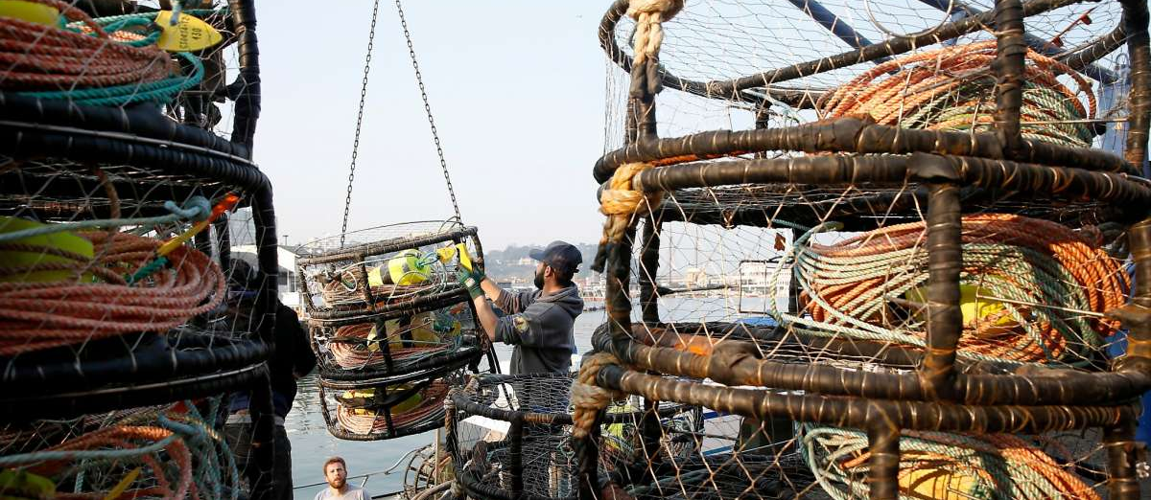




Climate-ready fisheries management in the California Dungeness crab fishery Crabs, HABs, and whales meeting | UC Santa Barbara | November 4, 2019

Slide 2
SFG effort
Goal
Identify tradeoffs among strategies for simultaneously managing domoic acid and humpback whale entanglement risk in the CA Dungeness crab fishery.
Data
Domoic acid: C-HARM
Whales: Humpback whale SDM
Crab fishery: Vessel-/block-level landings data
Analysis
Retrospective MSE (HABs+whales+crabs)
Forecasted MSE (HABs+whales+crabs)
Spatial scope
California only
NOAA effort
Goal
Identify tradeoffs among strategies for managing humpback and blue whale entanglement risk in the West Coast Dungeness crab fishery.
Data
Whales: Humpback and blue whale SDMs
Crab fishery: Trip-level VMS data
Analysis
Risk assessment (whales+crabs)
Retrospective tradeoff analysis (whales+crabs)
Forecasted MSE (whales+crabs)
Spatial scope
Coastwide (CA-OR-WA)
Fleet dynamics model
Population dynamics model code and forecasted ocean system data
Joint effort: MSE coastwide for HABs+whales+crabs

Slide 3
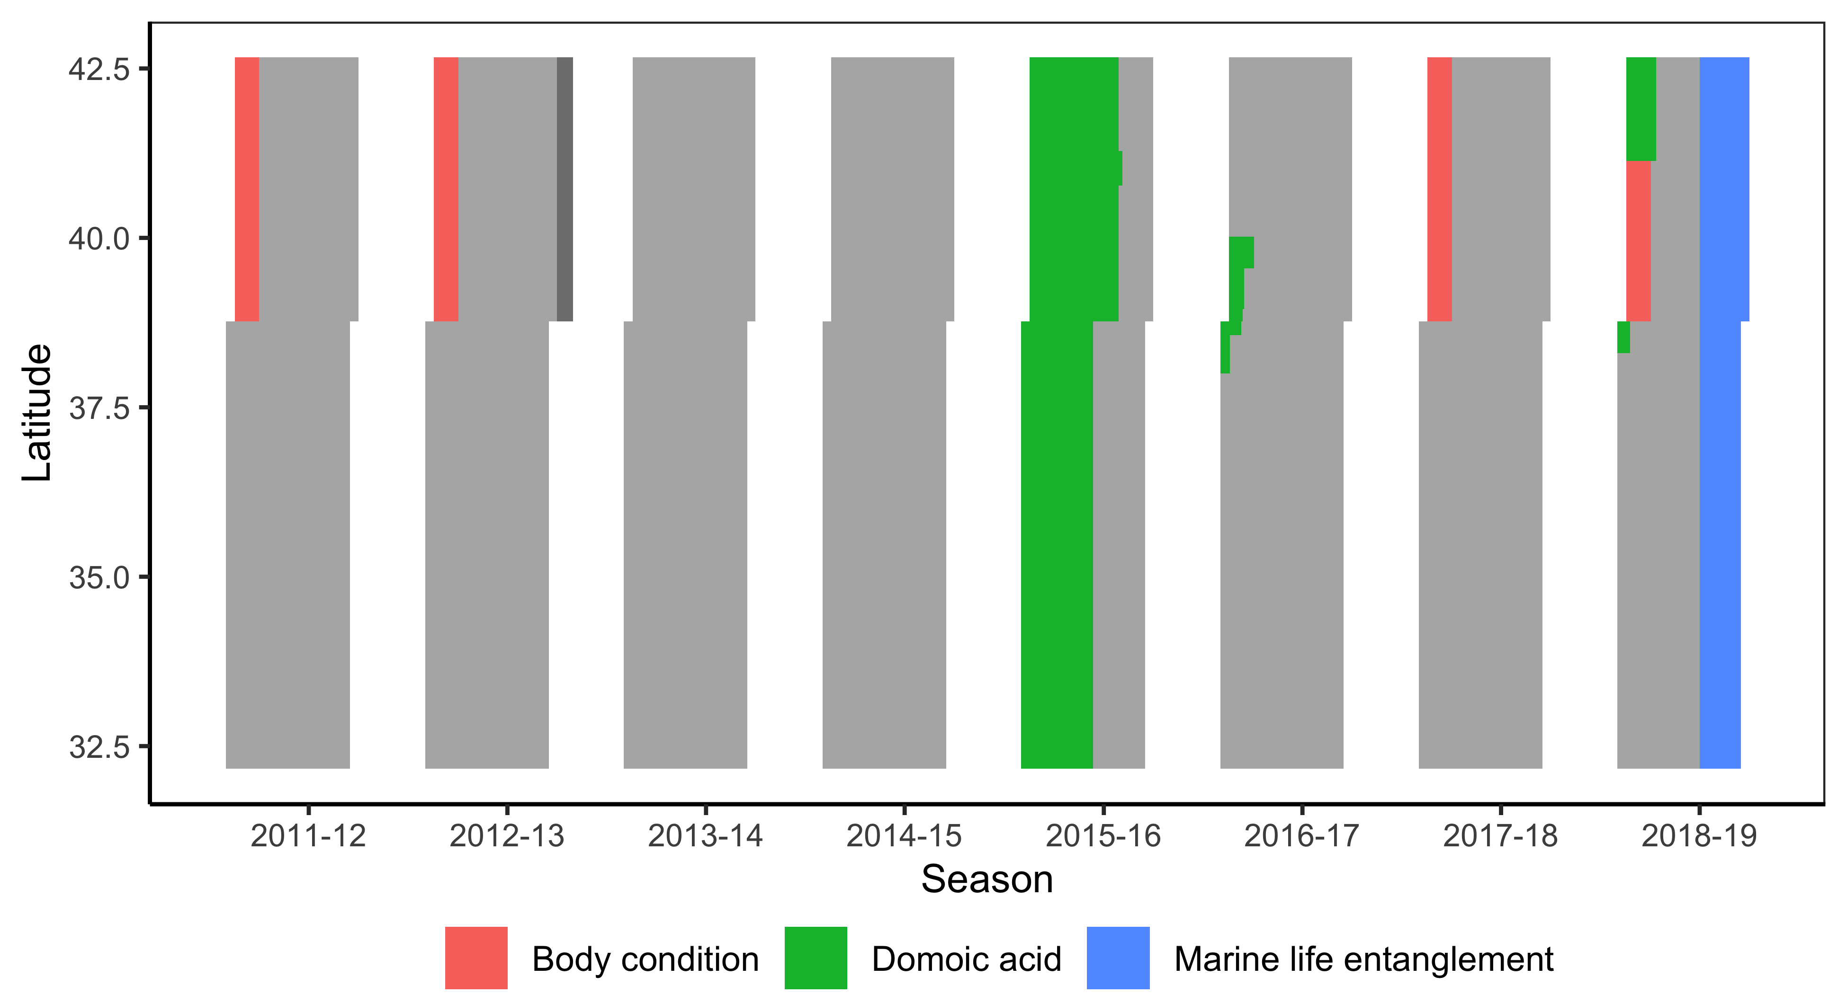

Slide 4
Current and alternative management strategies
Management measure | Current | Alternate
Domoic acid
Pre-season sampling | 6 areas x 2 locations
Mid-season sampling | Ad-hoc sampling
Management action | Space-time closure
Notes:
I’

Slide 5
Current and alternative management strategies
Management measure | Current | Alternate
Domoic acid
Pre-season sampling | 6 areas x 2 locations | More areas
Mid-season sampling | Ad-hoc sampling | Routine sampling
Management action | Space-time closure | Evisceration order
Notes:
I’

Slide 6
Current and alternative management strategies
Management measure | Current | Alternate
Domoic acid
Pre-season sampling | 6 areas x 2 locations | More areas
Mid-season sampling | Ad-hoc sampling | Routine sampling
Management action | Space-time closure | Evisceration order
Whale entanglement
Risk assessment frequency | 4x
Risk assessment framework | 4 indicators of elevated risk
Management action | Space-time closure
Notes:
I’

Slide 7
Current and alternative management strategies
Management measure | Current | Alternate
Domoic acid
Pre-season sampling | 6 areas x 2 locations | More areas
Mid-season sampling | Ad-hoc sampling | Routine sampling
Management action | Space-time closure | Evisceration order
Whale entanglement
Risk assessment frequency | 4x | 12x
Risk assessment framework | 4 indicators of elevated risk | 4 indicators of risk (precautionary)
Management action | Space-time closure | Space-time closure
Performance metrics: (1) amount of lost catch; (2) amount of contamination catch; (3) number of humpback entanglements; and (4) cost of management (depending on data availability)
Notes:
I’

Slide 8
Fleet dynamics
Biophysical processes
Monitoring programs
Management procedures
Harmful algal blooms (HABs)
Pier HAB monitoring
HAB and domoic acid monitoring
Space-time closures or evisceration
Bivalve monitoring
Contamination
Fishing
Dungeness
crabs
Viscera sampling
Sex-size-season (SSS) system
Targeted capture
Aerial + shipboard surveys
Incidental take through entanglement
Humpback whales
Whale and entanglement monitoring
Space-time closures
Entangle-ment
reports
Frequency, duration, and toxicity driven by ocean conditions
Abundance and distribution driven by oceans and forage fish
Forage fish (krill and anchovies)
Surveys and stock assessments
Risk Assessment and Mitigation Program (RAMP)
Oceans
Ocean observation programs

Slide 9
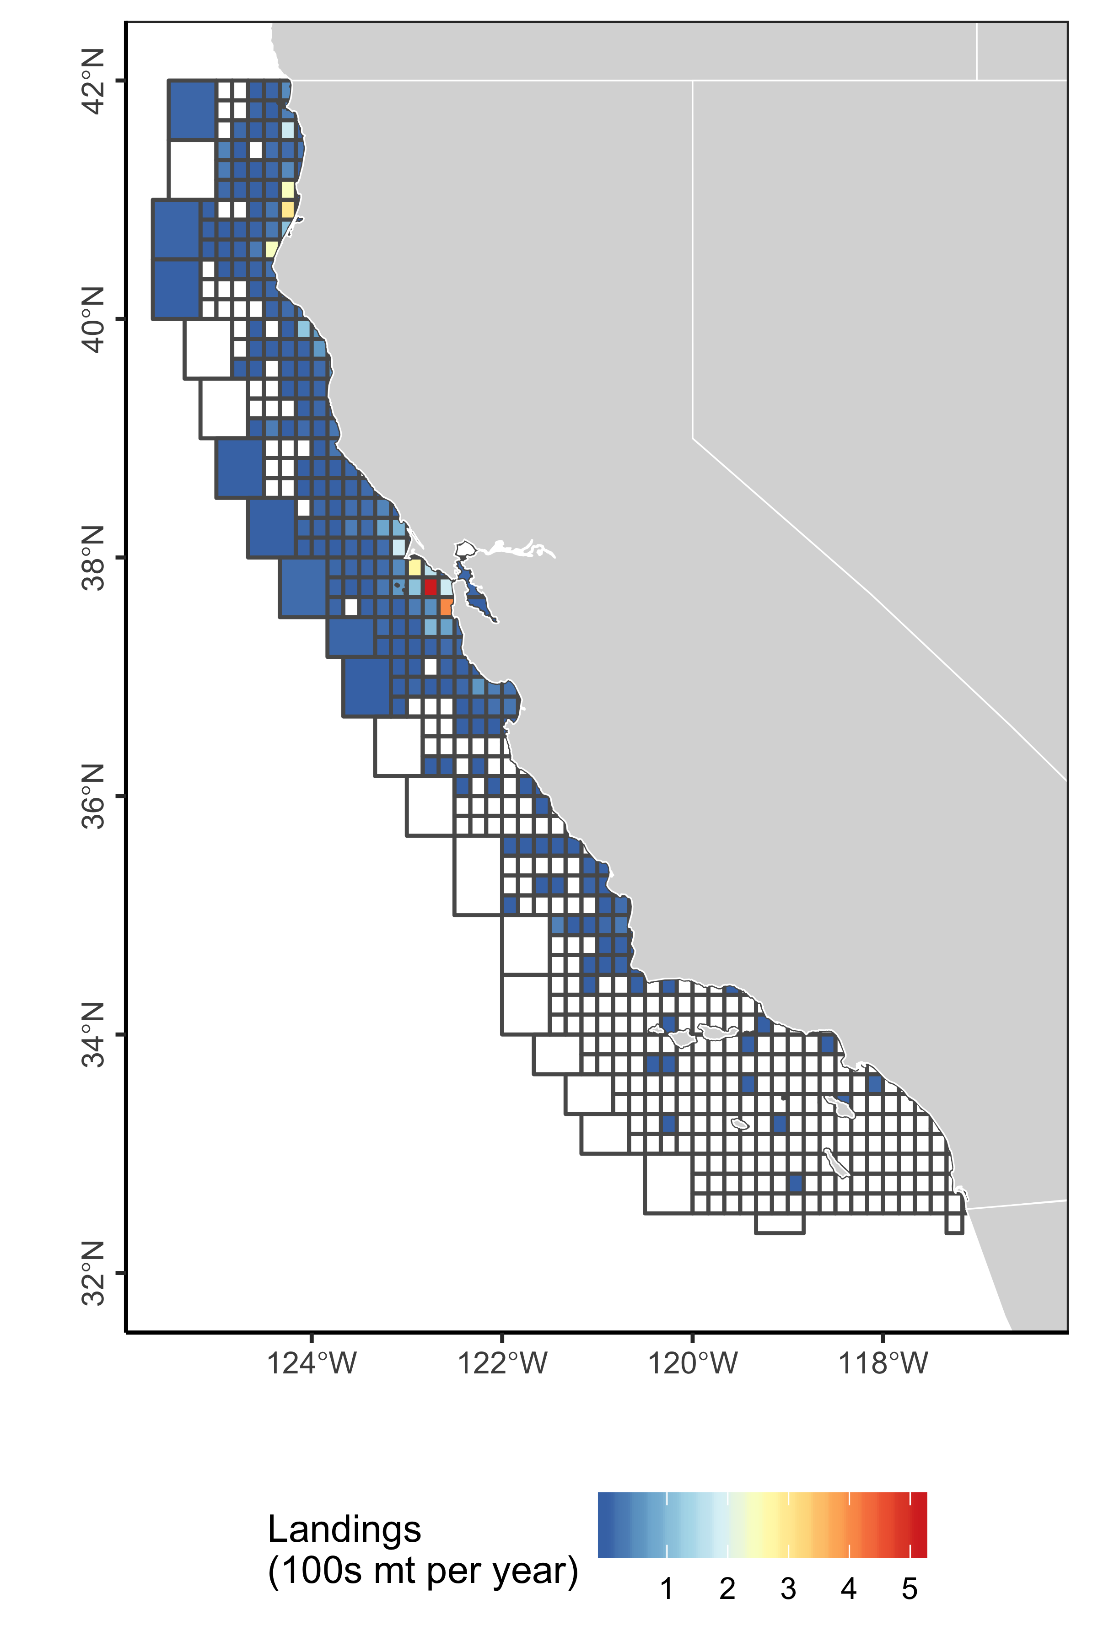
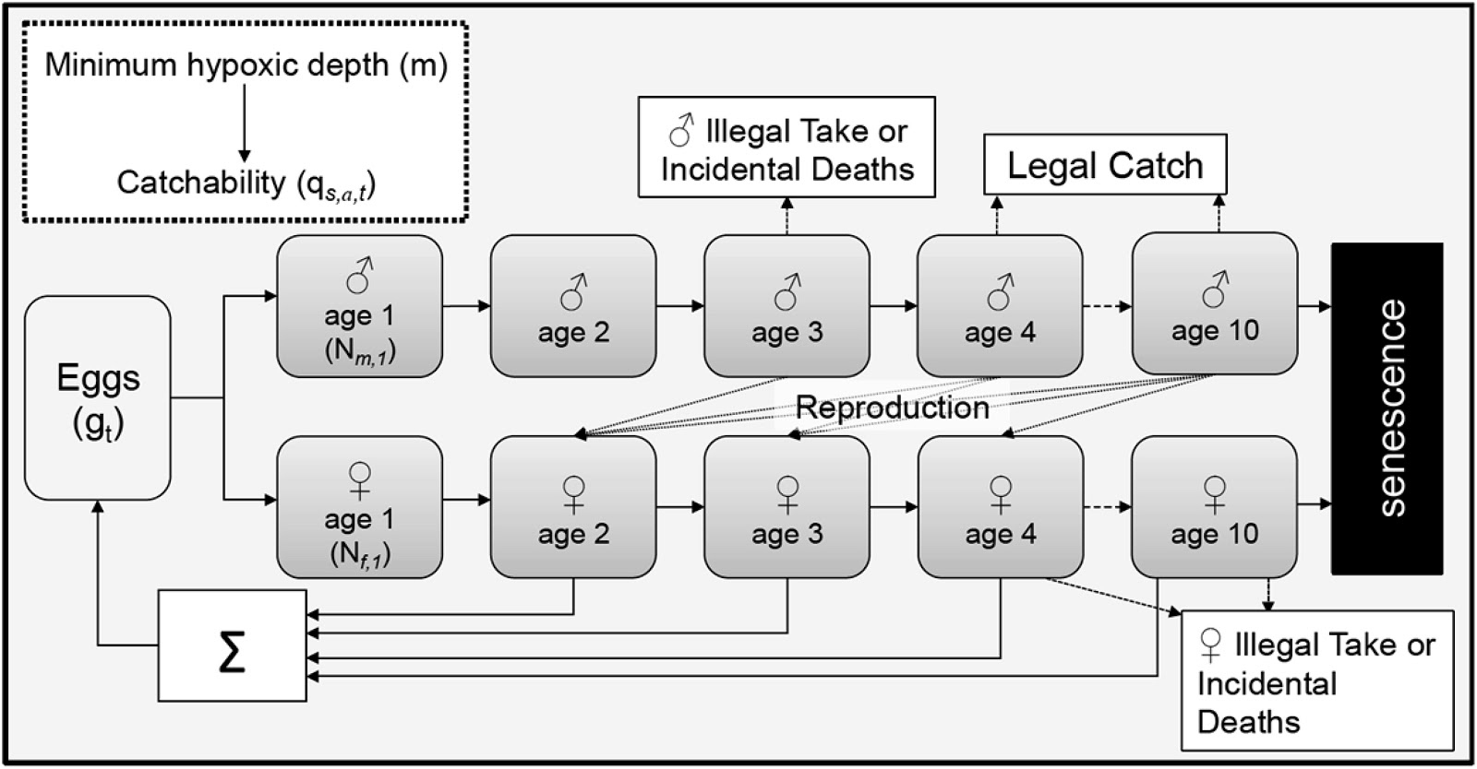
1. Population dynamics model
An age- and sex-structured population dynamics model spatially organized by CA commercial fishing blocks, operating on weekly time steps from March 2014 to July 2019, based on Froehlich et al. 2017.
A) Spatial dynamics
B) Age- and sex-structured dynamics
Froehlich et al. 2017

Slide 10
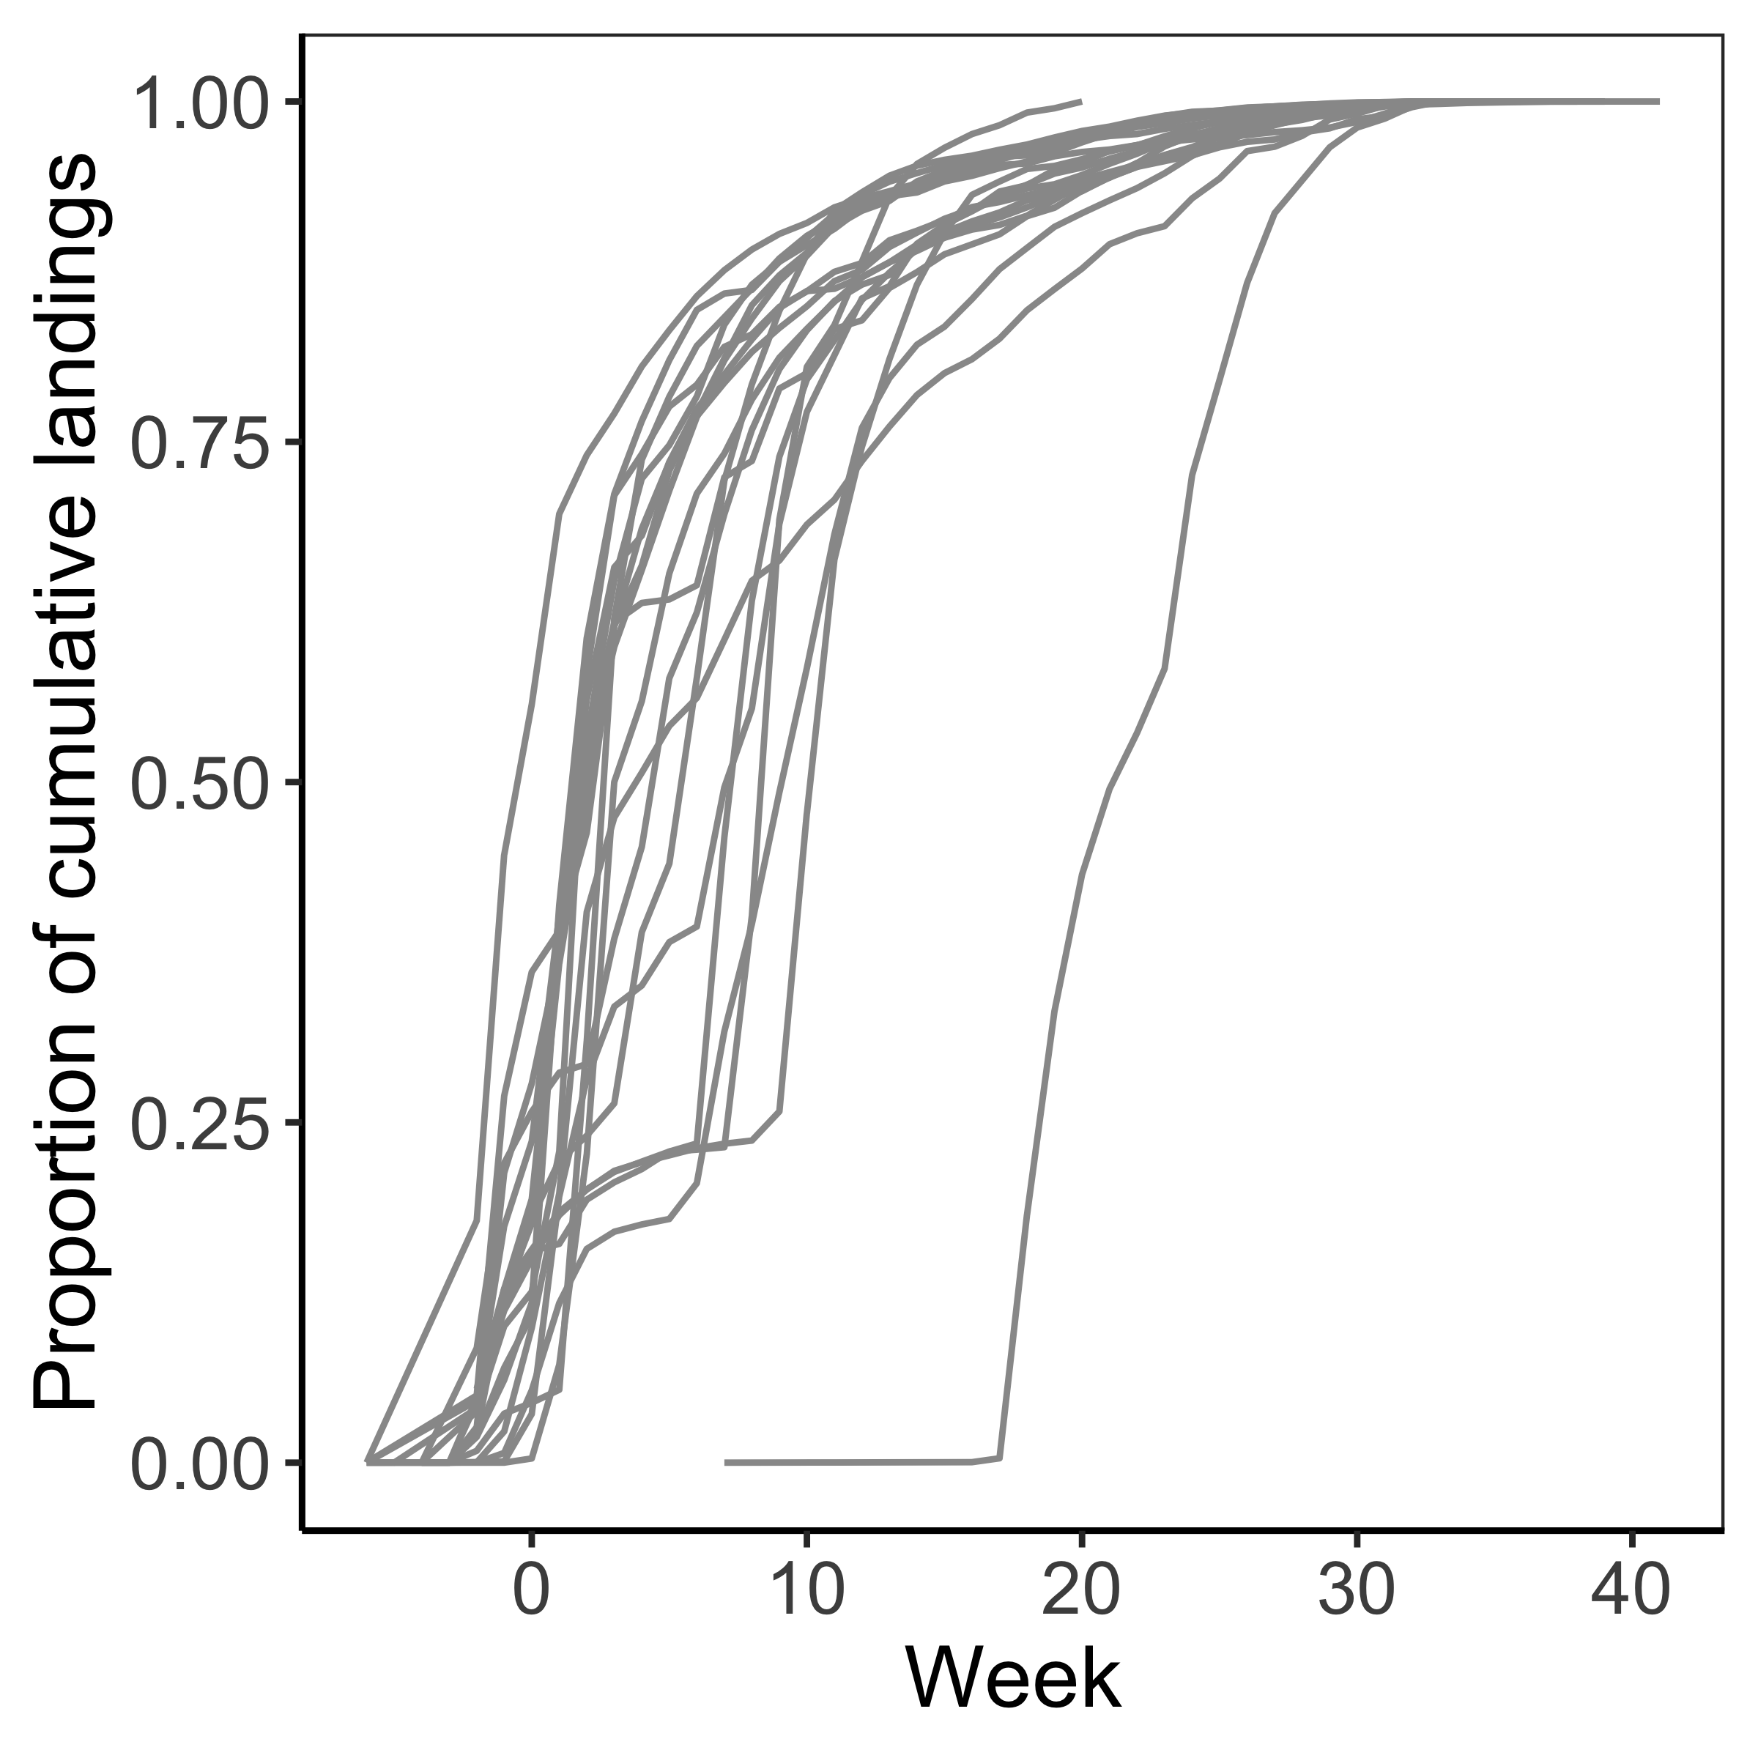
2. Effort dynamics model
A model of spatial-temporal fishing dynamics based on either (1) Owen Liu and Jameal Samhouri’s fleet dynamics model or (2) based on an open access fishing model tuned to CDFW landings data.
A) Spatial dynamics
B) Temporal dynamics

Slide 11
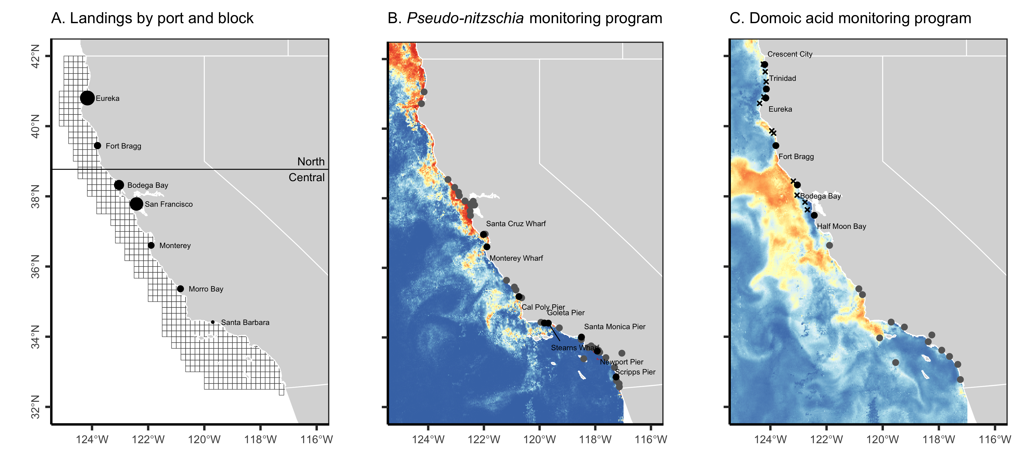
3. Domoic acid contamination model
We modeled the contamination of Dungeness crabs with domoic acid using CDPH viscera contamination data and predictions of high particulate domoic acid risk from C-HARM (Anderson et al. 2016).
We also simulated the monitoring of the following indicators of elevated domoic acid risk using C-HARM and CDPH field observations:
Crab contamination
Bivalve contamination
Pier-monitoring of Pseudo-nitzschia
Questions
1) What are the criteria for bivalve / pier monitoring programs to trigger viscera sampling?
2) Are expanded pre-season sampling, routine mid-season sampling, or evisceration orders viable?
3) What is the cost of monitoring and evisceration?
Notes:
What are the

Slide 12
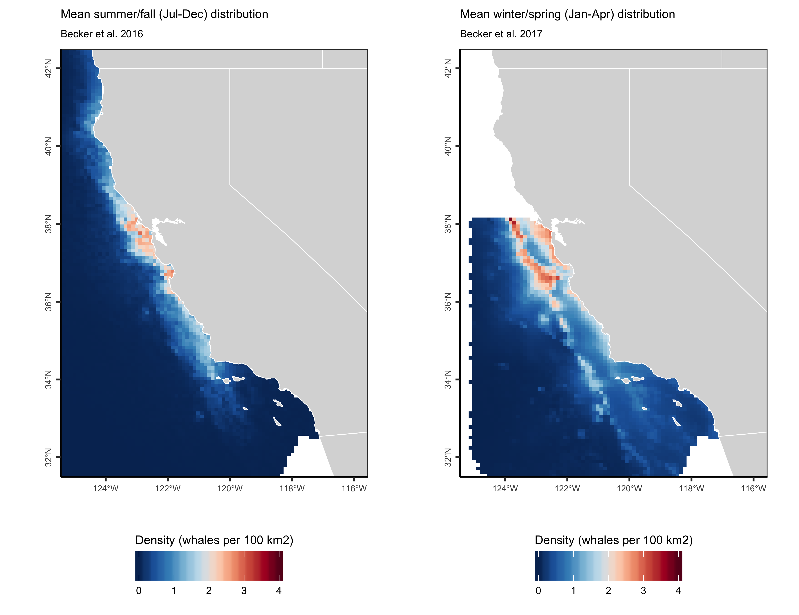
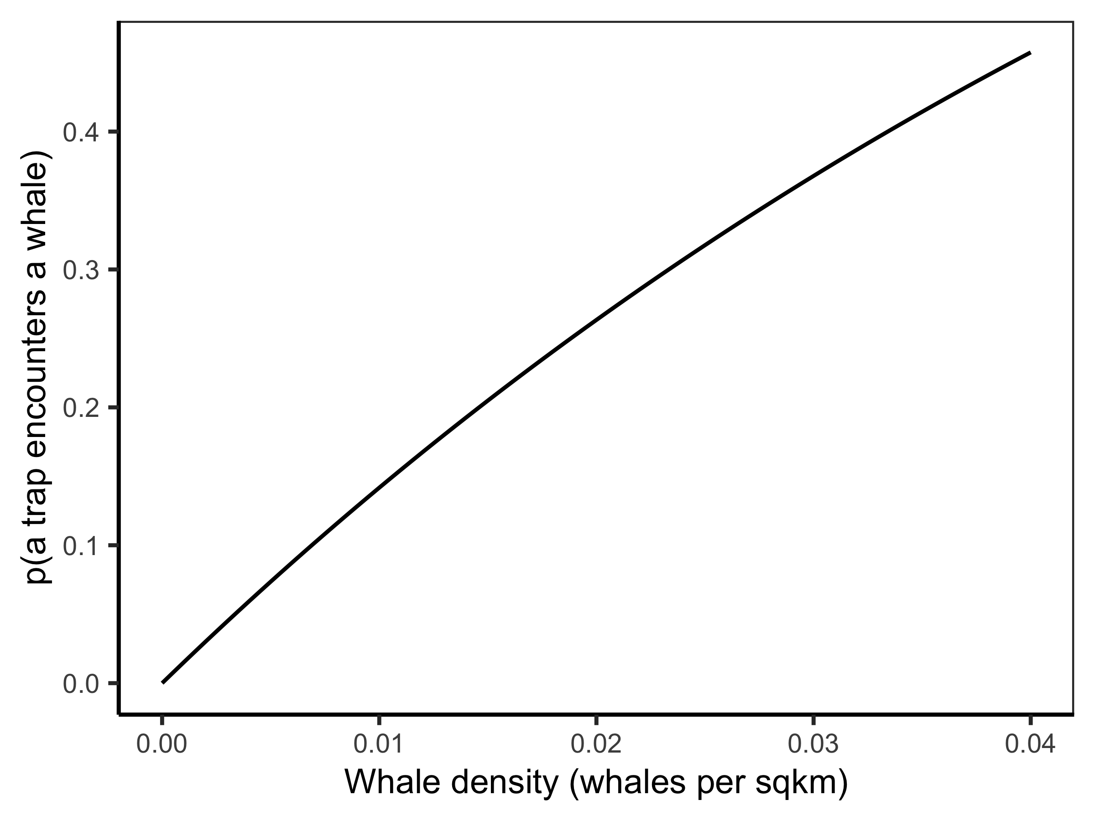
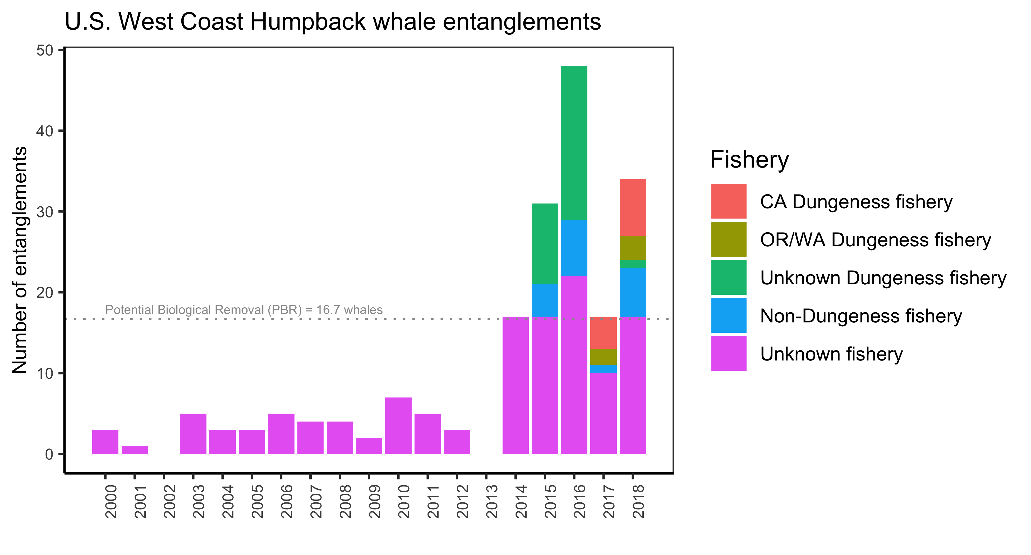
4. Whale entanglement model
We propose to simulate the density of humpback whales using the Forney et al. (in prep) species distribution model. We will derive the probability that a whale encounters a trap using ideal gas theory and tune the probability that a whale becomes entangled in an encountered trap to historical rates of entanglement.
Step 1. Whale density
Step 2. Probability that a whale encounters a trap (ideal gas theory)
Step 3. Probability that a whale becomes entangled in an encountered trap (NOAA 2019)
Questions
How many whales get entangled in CA-DC fishing gear? 5-25 per year?
What proportion of whales that become entangled are observed?
Becker et al. 2016

Slide 13
5. Monitoring and management model
We simulate the sampling programs used to monitor domoic acid and whale entanglement risk and simulate the management procedures used to mitigate these risks.
Management measure | Current | Alternate
Domoic acid
Pre-season sampling | 6 areas x 2 locations | More areas
Mid-season sampling | Ad-hoc sampling | Routine sampling
Management action | Space-time closure | Evisceration order
Whale entanglement
Risk assessment frequency | 4x | 12x
Risk assessment framework | 4 indicators of elevated risk | 4 indicators of risk (precautionary)
Management action | Space-time closure | Space-time closure
Performance metrics: (1) amount of lost catch; (2) amount of contamination catch; (3) number of humpback entanglements; and (4) cost of management (depending on data availability)
Notes:
I’

Slide 14
5. Simulating the RAMP framework
We have to simulate the following risk indicators:
Presence of species of concern
>20 whales in a single survey
>5 whale running average over 1 week of survey
“Fall marine mammal aerial survey” or “spring rockfish shipboard survey”
Number of confirmed ESA-listed entanglements
Fleet dynamics
Beginning of every season
Any delayed season
Ocean conditions
Upwelling is below average
Low offshore krill abundance, high inshore anchovy abundance
Challenging because criteria are vague and surveys are not clearly specified.
Easy, this is baked into the simulations.
(but only humpbacks, not all ESA-species)
Easy, this is baked into the simulations.
Based on SST data?
Based on CA Current Ecosystem Survey (CCES)?
When triggered, what is the spatial and temporal extent of the closure?

Slide 15
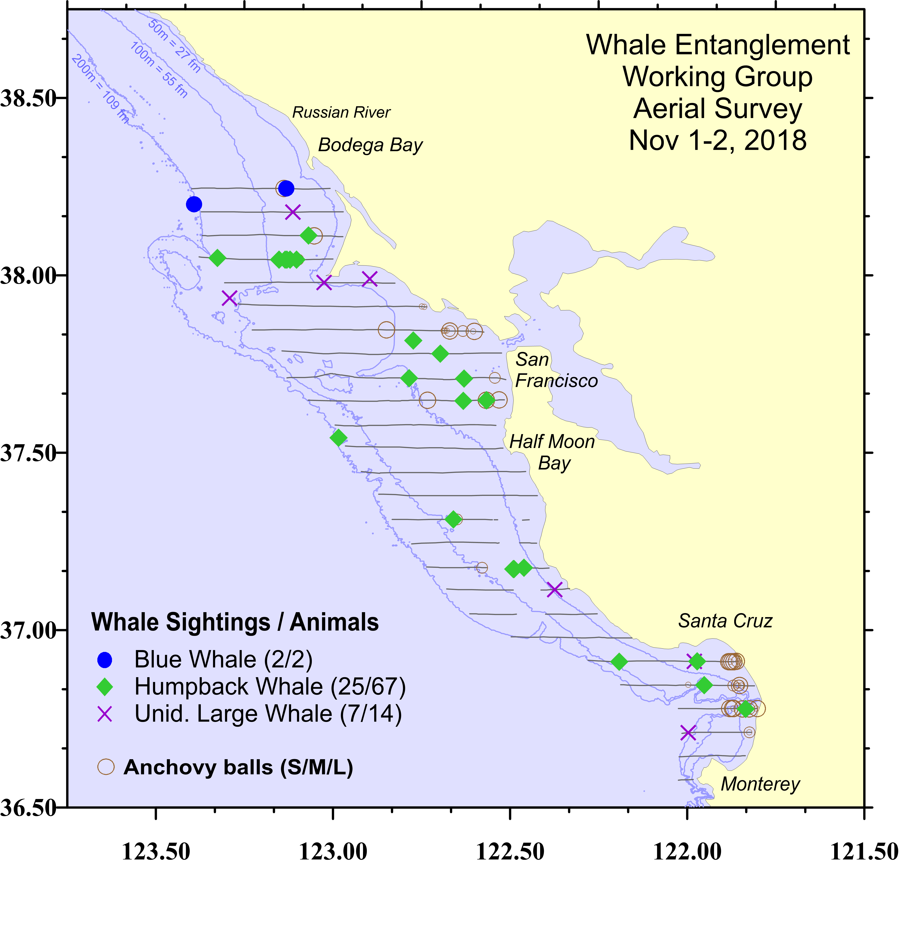
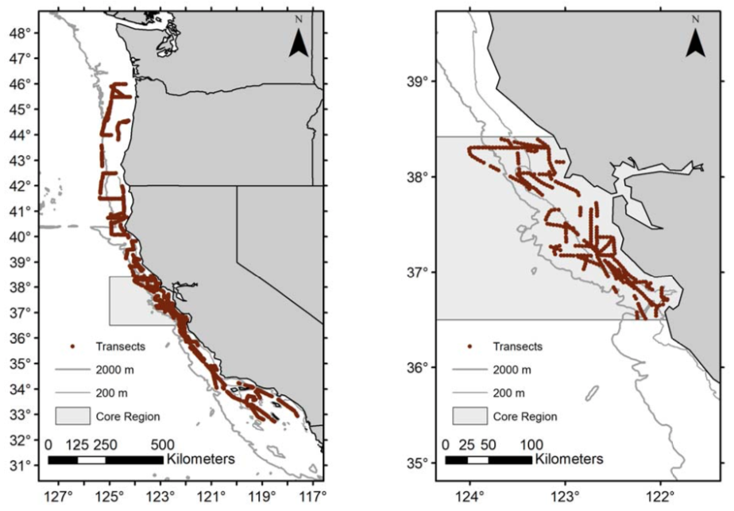
5. Simulating the RAMP framework
Indicator #1: Presence of species of concern
>20 whales in a single survey or average of >5 whales over one week of a survey
“Fall aerial marine mammal survey”
Forney, personal communication
“Spring shipboard rockfish survey”
Sakuma 2017
Full region
37 days
87 humpbacks
Core region
18 days
17 humpbacks

Slide 16
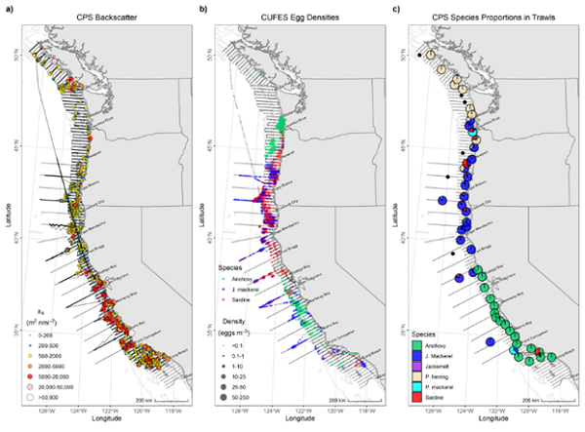
5. Simulating the RAMP framework
Indicator #4: Forage conditions
Low offshore krill abundance, high inshore anchovy abundance
The California Current Ecosystem Survey (CCES) provides data on the abundance and distribution of anchovy and krill.
We could monitor krill/anchovy abundance and distribution using this data directly or a model based on this data.
I haven’t worked on this component yet.

Slide 17
Questions to make sure we discussed
Domoic acid problem
Is our understanding of current management correct?
Are the proposed alternative management options viable and comprehensive?
Are there objective criteria for triggering mid-season viscera sampling based on the bivalve biotoxin and pier Pseudo-nitzchia monitoring programs?
What is the cost of collecting and processing a crab viscera sample?
What is the cost of an evisceration order?
Whale entanglement problem
Is our understanding of current management correct?
Is our understanding of the settlement stipulations correct?
Are there other management strategies we should consider?
Questions over simulating entanglement rates:
How many whales get entangled in CA DC gear per year? 5-25?
What proportion of whales that get entangled are observed?
How should we simulate the following risk indicators:
Whale surveys – fall aerial marine mammal and spring rockfish survey?
Forage conditions – how to best simulate krill/anchovy dynamics
How do we match spatial-temporal extent of closures to risk indicators?

